Slide 1
Machine Learning II
” You can’t process me with a normal brain.”
— Charlie Sheen
Lecture 1
Neural Networks basic

Slide 2
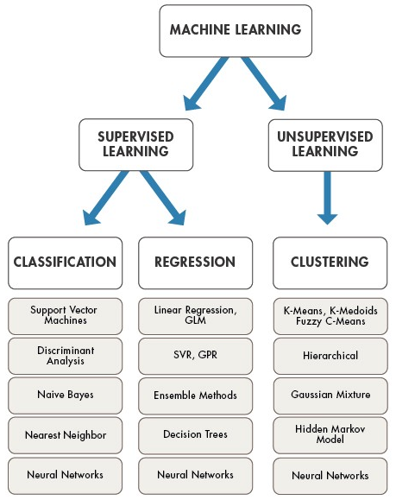

Learning Algorithms
Reinforcement learning (RL) is an area of machine learning concerned with how software agents ought to take actions in an environment so as to maximize some notion of cumulative reward.
Wikipedia
https://medium.com/technology-nineleaps/popular-machine-learning-algorithms-a574e3835ebb

Slide 3
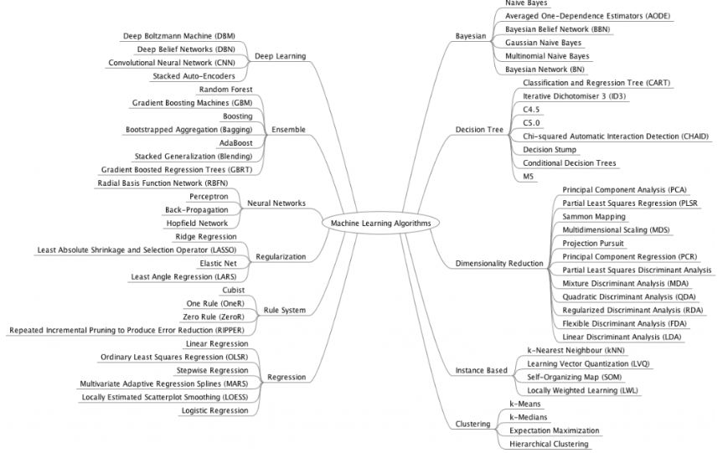
https://dsla1.com/machine-learning-techniques/

Slide 4
Neural Networks
An artificial network consists of a pool of simple processing units which communicate by sending signals to each other over a large number of weighted connections.
NN, a beautiful biologically-inspired programming paradigm which enables a computer systems to learn from observational data
Deep learning, a powerful set of techniques for learning in neural networks
http://neuralnetworksanddeeplearning.com/

Slide 5
FIRST PASS
1943
Probabilistic interpretations, Bayesian and spiking networks
McCulloch–Pitts “neuron”
Started the field
LEARNING IMPROVEMENT
02
04
1962
Rosenblatt’s perceptron
Learned its own weight values; convergence proof
HOW ABOUT LAYERS?
1969
Minsky & Papert Proved limitations of single-layer perceptron networks
01
03
05
1982
ENERGY FUNCTION
Hopfield and convergence in symmetric networks
MORE TUNNING
1986
Backpropagation of errors
Method for training multilayer networks
NN Evolution

Slide 6
Why do we use NN?
Neural networks, with their remarkable ability and potentials to derive meaning from complicated or big data, can be used to extract patterns and detect trends that are too complex or at least that are not easy to be noticed by either me and you as humans or other computer techniques.
Adaptive learning: An ability to learn how to do tasks based on the data given for training or initial experience.
Self-Organization: An ANN can create its own organization or representation of the information it receives during learning time.
Real Time Operation: ANN computations may be carried out in parallel, and special hardware devices are being designed and manufactured which take advantage of this capability.
Fault Tolerance via Redundant Information Coding: Partial destruction of a network leads to the corresponding degradation of performance. However, some network capabilities may be retained even with major network damage.

Slide 7
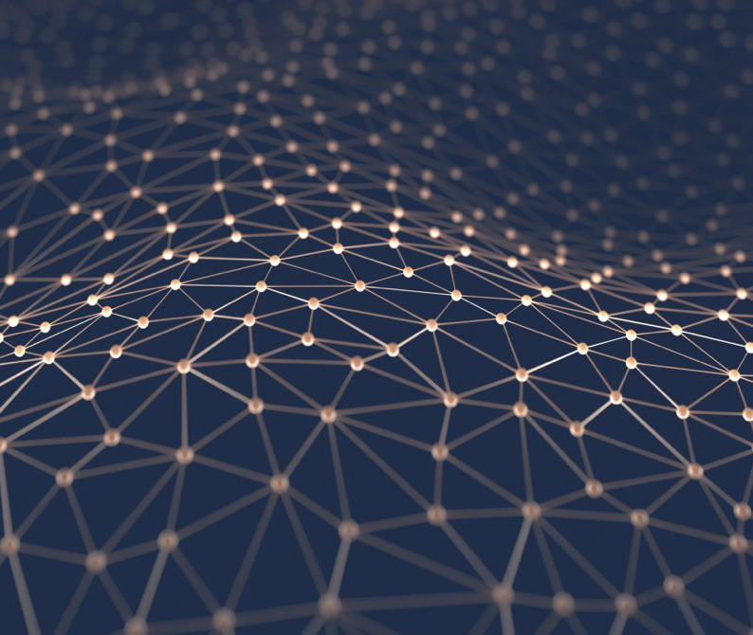
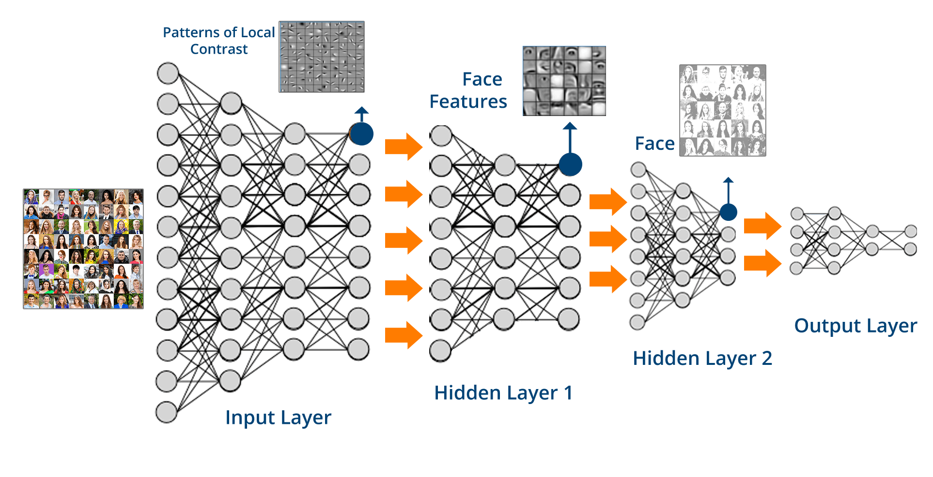
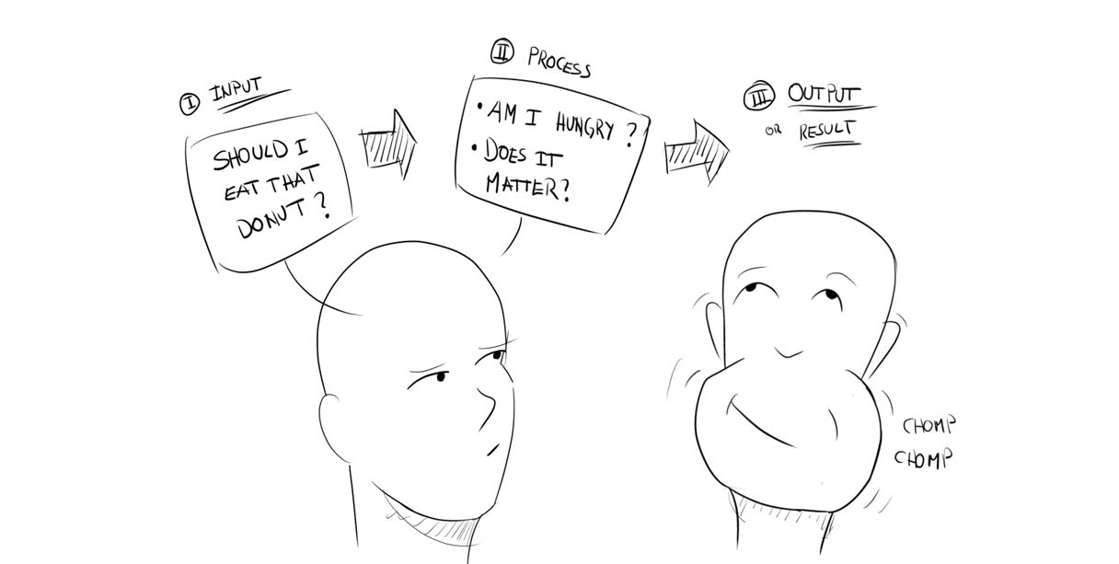
Applications
https://becominghuman.ai/making-a-simple-neural-network-2ea1de81ec20

Slide 8
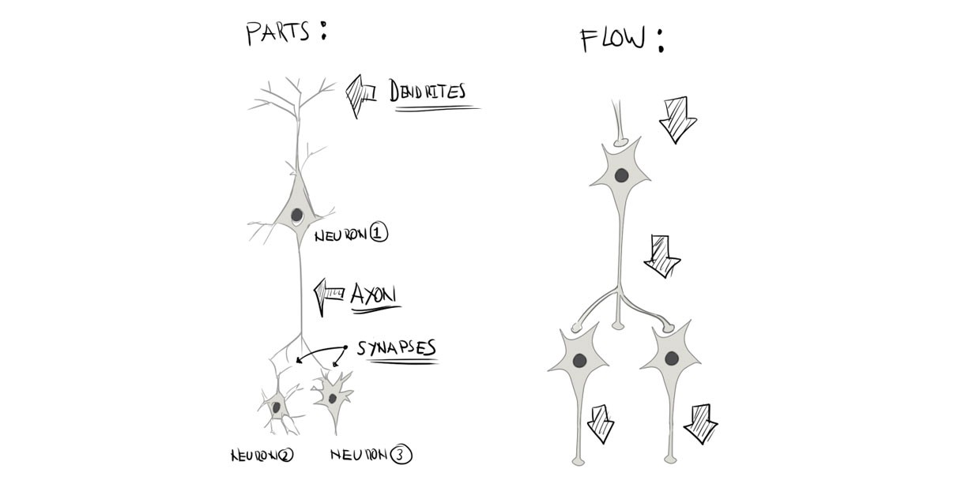
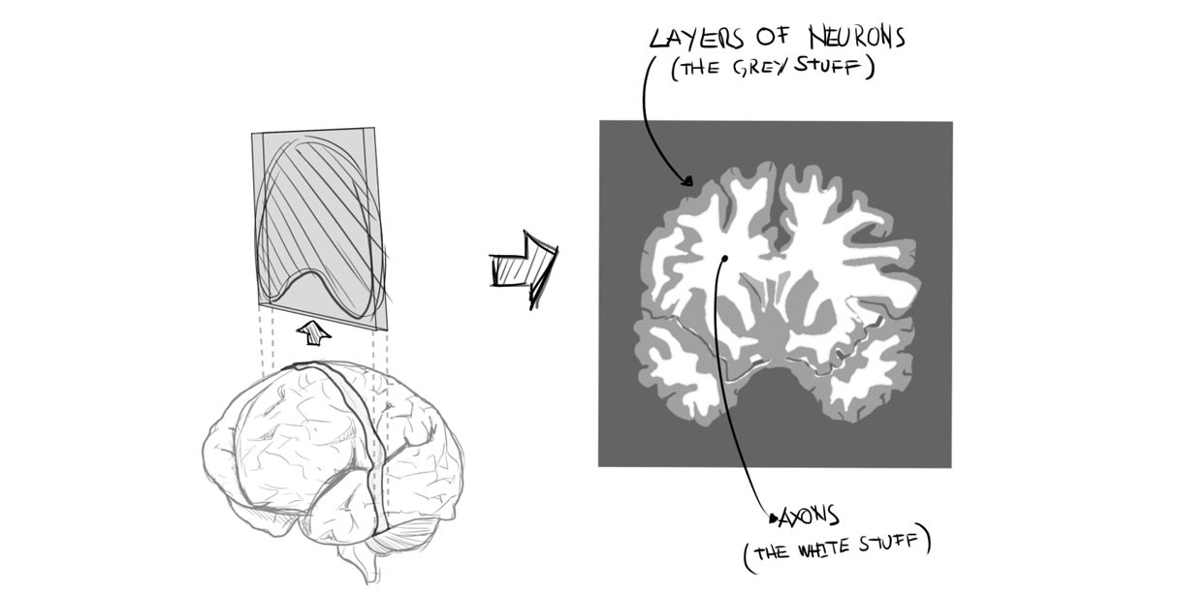
How does human brain work?
In the human brain, a typical neuron collects signals from others through a host of fine structures called dendrites.
The neuron sends out spikes of electrical activity through a long, thin stand known as an axon, which splits into thousands of branches.
At the end of each branch, a structure called a synapse converts the activity from the axon into electrical effects that inhibit or excite activity in the connected neurons.
When a neuron receives excitatory input that is sufficiently large compared with its inhibitory input, it sends a spike of electrical activity down its axon.
Learning occurs by changing the effectiveness of the synapses so that the influence of one neuron on another changes.
https://becominghuman.ai/making-a-simple-neural-network-2ea1de81ec20

Slide 9

Neural Network
w_{1j}
x₁
w_{2j}
x₂
y_{j}
w_{nj}
x_{n}
b_{j}

